Slide 1


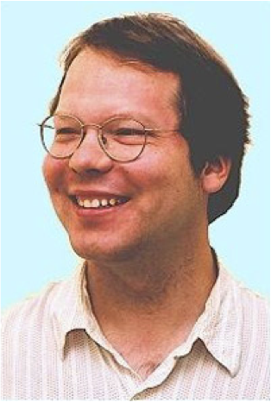



What is the value of an action in ice hockey?
Kurt Routley
Oliver Schulte
Zeyu Zhao
Tim Schwartz
Sajjad Gholami
Notes:
also SportLoqig and Mohammed

Slide 2
AI Meets Sports Analytics Meets Big Data
North American Sports: $485 Billion
Sports Analytics:
growing in industry.
$72.5M Investment in Hudl.
growing in academia.
#Sports Analytics papers 2008-2015 = 7x #applied operations research papers.
AI
modelling and learning game strategies.
multi-agent systems.
structured data.
Notes:
https://www.plunkettresearch.com/industries/sports-recreation-leisure-market-research/
hudl.com

Slide 3
Sports Analytics and AI
Many (all?) AI topics are relevant
sequential decision-making
multi-agent systems, game playing
spatio-temporal event modelling
relational and network data
general rules and exceptions; personalization

Slide 4

The Big Picture
Sports
Analytics
Reinforcement Learning
on-line intro text
by Sutton and Barto
Notes:
*Nice application for RL
*Revolutionary for sports analytics

Slide 5
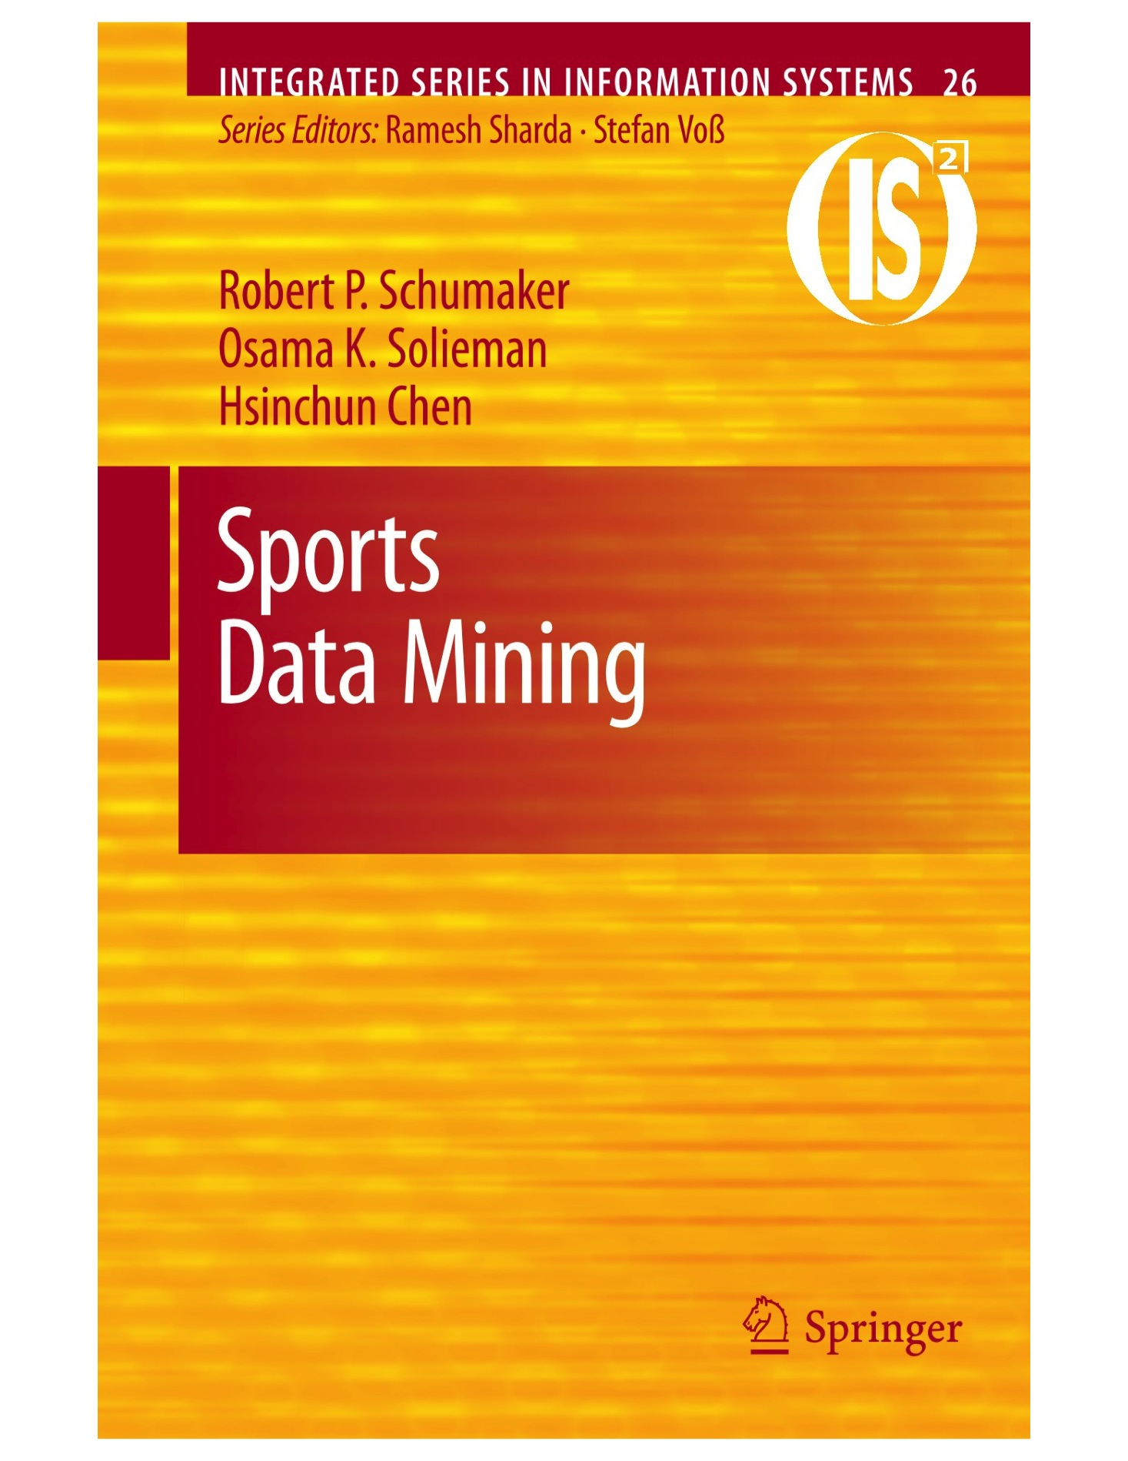
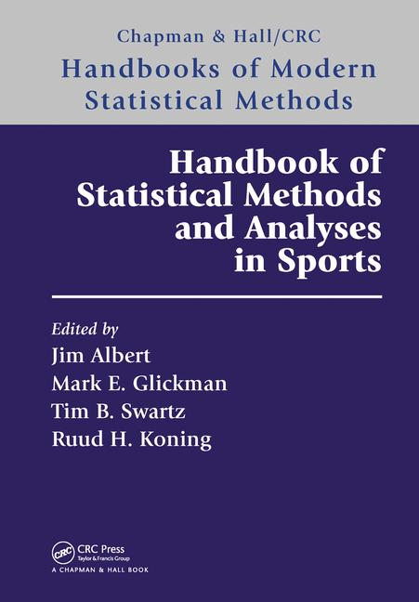
Two Main Problems in Sports Analytics
Sports Analytics
Evaluate Player/Team Performance
Predict Match Outcomes
relational!
Identify strengths, weaknesses
Advise on drafts, trades
Notes:
https://dtai.cs.kuleuven.be/events/MLSA15/index.php
Add money ball picture
Italics is for topic today.

Slide 6
Outline
A game simulator can be utilized for different tasks
assigning values to actions
assessing player performance
predicting game/series/league outcomes
Dynamic play-by-play data + reinforcement learning models ➔ stochastic game simulator.

Slide 7

Performance Evaluation

Slide 8
Performance Evaluation Approaches
Evaluate Player/Team Performance
Latent Strength Model Chess: Elo Rating
Gaming: MS TrueSkill
Action Counts
Assign Values to Actions
Add values of all actions by a player
Players Total Score
Issues
entails transitivity
interpretable?
considers final match results only
Notes:
https://dtai.cs.kuleuven.be/events/MLSA15/index.php
Add money ball picture
Italics is for topic today.

Slide 9
What is the value of an action?
Belgium-Hungary Euro 2016
Canada-USA Olympics 2010
Issues for action values:
Common scale for all actions
Context-awareness
Look-ahead to consequences
Notes:
https://www.youtube.com/watch?v=RBol-8Gfo5g
go to about 3 min into
Discuss issues:
context matters: not all goals are equal. Need to know score, overtime.
what about negative points for defenders?
What about Igla assisting? How much is an assist worth vs. a goal?
What about other players on the ice further behind?
What about medium-term events – passes, penalties?
The problem is that we have a continuous flow nonepisodic game
----------
Belgium example:
Belgium-Hungary Euro 2016 highlights
http://www.uefa.com/uefaeuro/video/highlights/videoid=2389114.html
2:25
4th goal
shows player alone in front of goalie
reward for pass
context-dependence: this goal is not so important: temporal context, score context
1:14
missed chance
interception impressive, volley
reward for expected goals, not only actual goals
punish for missing alone in front of goalie: scoring chance goes down
1:35
again player alone in front of goalie
most credit should go to passer
also should give credit for beautiful lift at the beginning of the attack
might go back even more, e.g. turnovers in defensive zone. In the NHL: 14 steps

Slide 10
Reinforcement Learning and Action Values

Slide 11
The Q-function
The action-value function in reinforcement learning is just what we need.
Incorporates
context
look-ahead
Familiar in AI, revolutionary in sports analytics!

Slide 12
The Value Function
Fix a game state s.
The value of s for a team is the expected reward for the team if the game starts in s.
Our approach today:
the value of s for a team T is the chance that the team T scores the next goal if the game starts in s.
Notes:
this is a specific choice of reward functin
maybe do dynamic example of Belgium’s scoring chance at time t: goes up when striker is alone in front of goal, goes down after miss

Slide 13
Basketball: Value Ticker
Notes:
Q-value ticker
look for ice hockey ticker

Slide 14
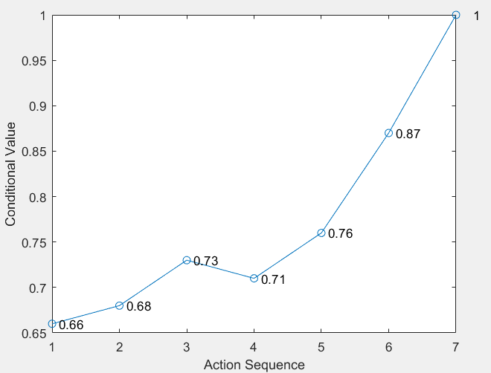
Hockey Value Ticker

Slide 15
Action Impact
V(s) = expected reward = value at state s
Q(s,a) = action value function
Expected reward after action
Expected reward before action
How much does the action change the expected reward (= value) at the current state?
Example: how much does the action change the chance of scoring the next goal?

Slide 16
State Values and Game Simulation

Slide 17
Estimating State Values
Basic idea: simulating a game
run n simulations starting in state s
count c_{T}(s) how often the team T scores the next goal within any number of steps
estimated value of s for team T: n/c_{T}(s)
Example:
100,000 runs
80,000 runs the home team scores the next goal
value for home team: estimated value = 80%
Notes:
no team may score

Slide 18
Video Games as Simulation
Simulated World Cup Final Germany-Argentina
Predictions from Electronic Arts NHL 2016 simulations
Video games have deterministic state transitions
Wanted: nondeterministic, probabilistic
Notes:
notice that Canucks are at bottom in EA
for current standings, see http://www.espn.com/nhl/standings Pacific Division

Slide 19
Simulation and the Curse of Dimensionality
Basic trade-off: include as much information as necessary, but no more.
Statistical formulation: introduce as many parameters as needed but no more.
Notes:
maybe the fundamental problem of intelligence as well

Slide 20
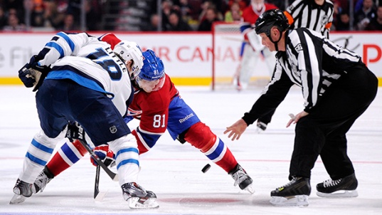
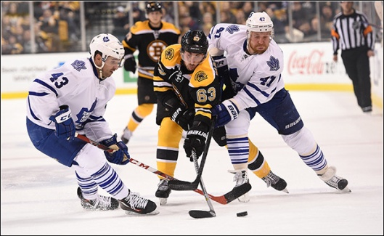
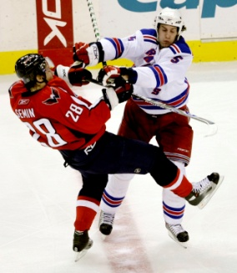
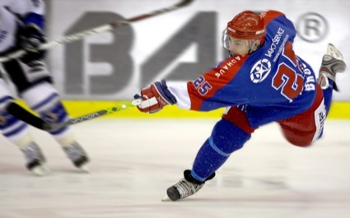
A Markov Game Model for the NHL
How to build a stochastic NHL simulator

Slide 21
Local Transition Probabilities
Two Key Quantities:
P(a|s) Probability of action given state Basketball Demo - Open in Chrome
P(s’|a,s) Probability of next state given current state and action.
Notes:
probability of action given state is called policy
http://projects.yisongyue.com/bballpredict/

Slide 22
Play-by-Play Data
gameId | playerId | teamID | Period | x | y | Manpower | Action Type
849 | 402 | 15 | 1 | -9.5 | 1.5 | Even | Lpr
849 | 402 | 15 | 1 | -24.5 | -17 | Even | Carry
849 | 417 | 16 | 1 | -75.5 | -21.5 | Even | Check
849 | 402 | 15 | 1 | -79 | -19.5 | Even | Puckprot
849 | 413 | 16 | 1 | -92 | -32.5 | Even | Lpr
849 | 413 | 16 | 1 | -92 | -32.5 | Even | Penalty
849 | 389 | 15 | 1 | -70 | 42 | PowerPlay | Block
Notes:
event log data

Slide 23
Play-By-Play Data Stats
Source: nhl.com
2007-2015
No Locations
Source: SportLoqig
2015
Action Locations
NHL.com
Teams | 32
Players | 1,951
Games | 9,220
Events | 2,2827,467
SportLogiq
Teams | 32
Players | 2,233
Games | 446
Events | 1,048,576

Slide 24
Markov Game Model: State Space
Context Features
Goal Differential GD
Manpower Differential MD
Period PR
Location of Puck
Dataset | #States | #Actions | #Transition Probabilities
nhl.com | 1.3 M | 32 | 3.2 M
SportLogiq | 204 | 126 | 112,590

Slide 25
Example Trajectory (I)
transition probability = 5% depends on action
GD = Goal Differential MP = ManPower PR = Period CV = chance that home team scores next goal
Notes:
Q-value ticker

Slide 26
Example Trajectory on Rink (I)
Notes:
Q-value ticker

Slide 27
Example Trajectory (II)
GD = Goal Differential MP = ManPower PR = Period CV = chance that home team scores next goal
Notes:
Q-value ticker

Slide 28
Example Trajectory on Rink (II)
Notes:
Q-value ticker

Slide 29
Example Trajectory (III)
GD = Goal Differential MP = ManPower PR = Period CV = chance that home team scores next goal
Notes:
Q-value ticker

Slide 30
Example Trajectory on Rink (III)
Notes:
Q-value ticker

Slide 31
Example Trajectory (IV)
Notes:
Q-value ticker

Slide 32
Example Trajectory on Rink (IV)
Notes:
Q-value ticker

Slide 33
Example Trajectory (V)
Notes:
fix arrows

Slide 34
Example Trajectory on Rink (V)
Notes:
Q-value ticker

Slide 35
Example Trajectory (VI)
Notes:
Q-value ticker

Slide 36
Example Trajectory on Rink (VI)
Notes:
Q-value ticker

Slide 37
Whole Trajectory on Rink
Notes:
Q-value ticker

Slide 38
State Value Estimation From Markov Model
Markov Chain Demo
our nhl.com model > 1M nodes
Instead of running simulation, can directly compute state values using dynamic programming
Solving a Markov Decision Process (for arbitrary look-ahead)
Value Iteration Demo

Slide 39
Learning the State Space
Alternative to fixing the state space in advance
Given an event history, how much does a system need to remember to predict the future accurately?
Hidden Markov Model
Neural Nets; recent successes in
playing go (alphago)
playing atari video games
group similar event histories (van Haaren, Sannoset and Davis 2016, Knauf and Bredel 2014)

Slide 40
Player Ranking Results
Routley, K. & Schulte, O. (2015), A Markov Game Model for Valuing Player Actions in Ice Hockey, in 'Uncertainty in Artificial Intelligence (UAI)', pp. 782--791.

Slide 41
Player Action Score
Markov Model
Assign Values to Actions
Add values of all actions by a player
Players Total Score
Action Values incorporate
context
look-ahead

Slide 42
Player Impact on Goals
2014-15 no location data
Notes:
Sort player values for 2014-2015 regular season and display top-25
No Canucks!
Jason Spezza is interesting case, low Pls minus but high goal impact. Played for senators, senators +- was very bad (-29 goal differential).
Jori Lehtera: High Points, low goals, we captures assists.
Sidney Crosby: high salary for goal impacts.
If you are into ice hockey, it's fun and revealing to look at the resulting rankings. For instance, all three members of St. Louis' famed STL line (Schwartz, Tarasenko, Lehtera) are among the top 20 in our list. In fact, Jori Lehtera tops our goal impact list, although his linemate Tarasenko outscored him by far. Our analysis suggests that Lehtera's actions create the opportunities that Tarasenko exploits, leading to a high goal impact ranking for Lehtera and a high goal score for Tarasenko. This pattern fits the traditional division of labor between a center and a wing player. Tarasenko is also the most undervalued player in our list. Starting with the 2015-2016 season, St. Louis has signed him for an annual average more than 7 times higher, which our analysis strongly supports. Another interesting case is Jason Spezza, who was on top of our goal impact list in the 2013-2014 season. However, his plus-minus score was an awful -26. This is because his team the Ottawa senators was even worse overall (-29 goal differential). The goal impact score rewards players for good decisions even if their teammates do not convert them into goals. After the 2013-2014 season, Spezza requested a trade, which according to our analysis was definitely the right thing for him to do. With the Dallas Stars, his plus-minus score came more in line with his goal impact score, as we would expect (-7 overall, still negative). As I mentioned, we also look at players' impact on penalties. Sadly, two Vancouver Canucks players take spots 2 and 4 when it comes to actions that lead to penalties (Dorsett and Bieksa). Even more sadly, none of the Canucks player make it into the top 20 when it comes to actions that lead to goals.

Slide 43
Consistency Across Seasons
Correlation coefficient = 0.703
Follows Pettigrew(2015)

Slide 44
Action Values: Previous Approaches
Sabermetrics in Baseball
Premier League Ranking
Premier League statistics
+/- Score in ice hockey
nhl.com
Advanced Stats
Notes:
sabermetrics: note how many there are!
Action examples. E.g. face-off win -> shot on target.
http://www.nhl.com/stats/player?navid=nav-sts-indiv#
http://thehockeymovement.com/advanced-stats-for-beer-league-hockey/

Slide 45
Other Results
Markov game model can answer many questions, e.g.
drill-down: in which game states are players especially strong or weak?
clustering: which players are similar to each other?
strategy: which actions are most effective, given a game state and location?
team evaluation: assess team performance
Notes:
once you have a simulator, can answer these questions

Slide 46
Jonas Vlasselaer’s Thesis

Slide 47
Simulation and the Curse of Dimensionality
Basic tension: include as much information as necessary, but no more.
In our spatial NHL model, we have 112,590 parameters to estimate.
Jonas’ thesis provides techniques for reducing the number of parameters.

Slide 48
Dynamic Bayesian Networks
Previous action | Previous manpower | Previous goal differential | Previous period | Next Action Probability
home team carries puck in region 4 | 0 | 0 | 3 | Home team passes in region 2: 21%
ditto | ditto | ditto | 2 | ditto: 20%
ditto | ditto | ditto | 1 | ditto: 22%
Time t
Time t+1
manpower
period
Team
Action
Action
Region
goal differential

Slide 49
Context-sensitive Independence
Previous action | Previous manpower | Previous goal differential | Previous period | Next Action Probability
home team carries puck in region 4 | 0 | 0 | 3 | Home team passes in region 2: 21%
ditto | ditto | ditto | 2 | ditto: 20%
ditto | ditto | ditto | overtime | ditto: 10%
probabilistic logical rules
carries(home,4,t), manpowerd(t)=0, gd(t) =0,period(t) ≠overtime ➔ passes(home,2,t+1): p= 21%
carries(home,4,t), manpowerd(t)=0, gd(t) =0,period(t) =overtime ➔ passes(home,2,t+1): p= 10%

Slide 50
Open Questions

Slide 51
Lower-Level Modelling
Fit parameters for each player/line/team (cricket, baseball, basketball).
Smooth towards similar players when a player visits a state rarely (Davis, Perera and Swartz 2015).
Combine reinforcement learning with clustering agents?

Slide 52
Let Continuous be Continous
Game Time.
Penalty Time.
Locations of puck, players (eventually).
Can we take existing continuous models of the shelf? E.g.
continuous-state reinforcement learning (e.g. Dearden 2005)?
control theory (Hamilton-Jacobi-Bellman equation)?
deep reinforcement learning (LSTMs)?
statistical process theory (marked point processes; Cervone et al. 2014)?

Slide 53
Conclusion
Modelling ice hockey dynamics in the NHL.
A configurable and scalable Markov Game model ➔stochastic game simulator
action impact function incorporates context and long-term effects of all actions.
A new context-aware method for evaluating locations, actions and players.
“We assert that most questions that coaches, players, and fans have about basketball, particularly those that involve the offense, can be phrased and answered in terms of EPV [i.e. the value function].” Cervone, Bornn et al. 2014.
Notes:
Continuous flow, non-episodic environment.

Slide 54

The End
Thank you – any questions?

Slide 55
References
Cervone, D.; D’Amour, A.; Bornn, L. & Goldsberry, K. (2014), POINTWISE: Predicting points and valuing decisions in real time with NBA optical tracking data, in MIT Sloan Sports Analytics Conference.
Routley, K. & Schulte, O. (2015), A Markov Game Model for Valuing Player Actions in Ice Hockey, in 'Uncertainty in Artificial Intelligence (UAI)', pp. 782--791.

Slide 56
Using Player Rankings
No ground truth.
Relate to predicting something (?)
Break down into strong and weak contexts?
Compare Apples-to-Apples.
Cluster players by position.
Learn player clusters.

Slide 57
Mining the Q-function
Extract patterns about which actions have the most impact when.

Slide 58
Value Learning for Ice Hockey
The Data
Notes:
value learning = V and Q learning

Slide 59
Sports Data Types
Complete Tracking: which player is where when. Plus the ball/puck. ★
Box Score: Action Counts.
Play-By-Play: Action/Event Sequence.
Notes:
Action vs. Event: not clearly distinguished.

Slide 60

Tracking Data
Basketball Example from SportsVU
Coming to the NHL?

Slide 61

Box Score
Oilers vs. Canucks

Slide 62
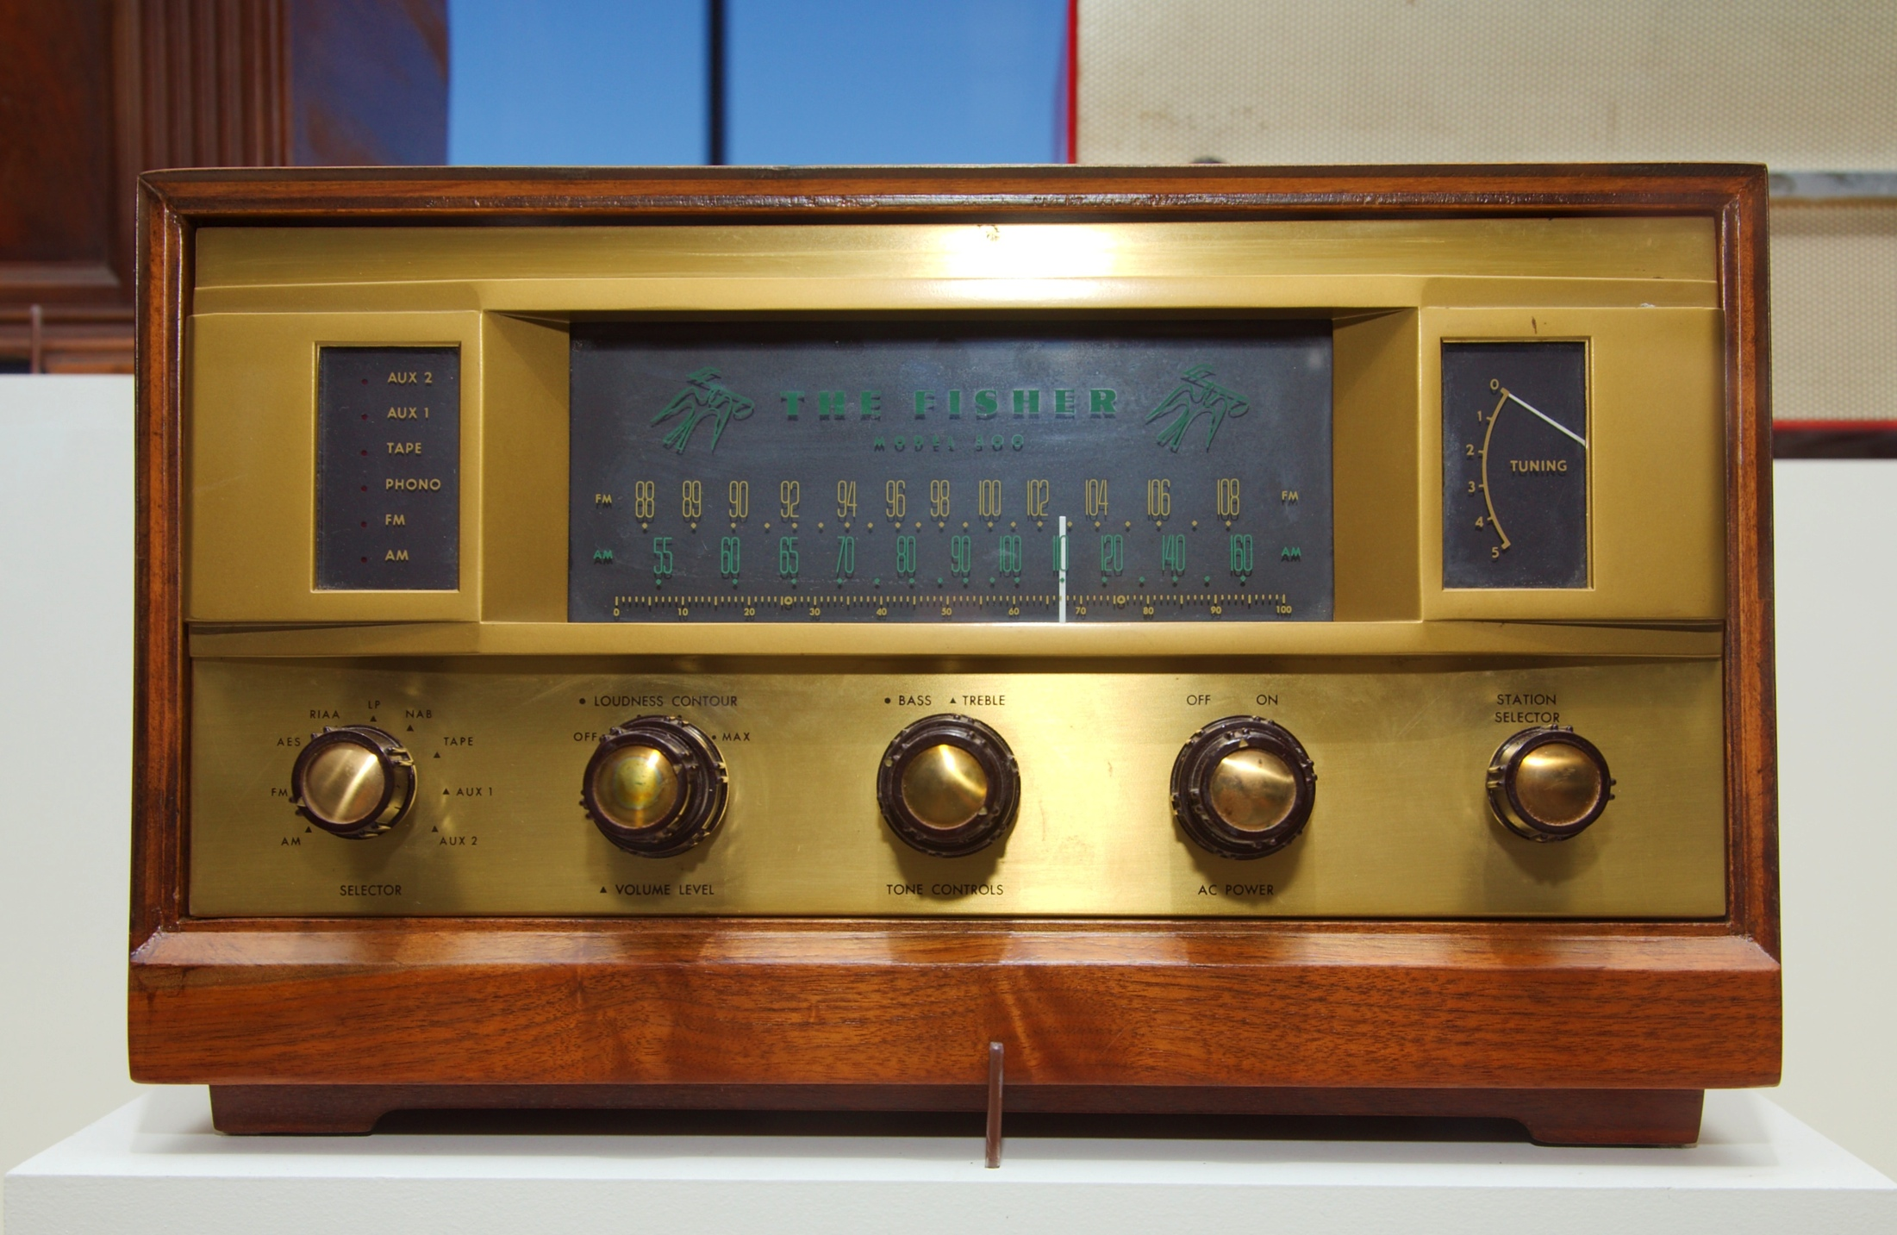
Play-By-Play
Successive Play Sequences
Notes:
https://www.youtube.com/watch?v=RBol-8Gfo5g
golden goal

Slide 63
Our Play-By-Play Data
Source: nhl.com
2007-2015
No Locations
Source: SportLoqig
2015
Action Locations
NHL.com
Teams | 32
Players | 1,951
Games | 9,220
Events | 2,2827,467
SportLogiq
Teams | 32
Players | 2,233
Games | 446
Events | 1,048,576

Slide 64
Performance Evaluation: Action-Based Approaches
Basic question: What difference does an action make?
Quantify effect of action on outcome (goal) = action value.
Player contribution = sum of scores of player’s actions.
Schuckers and Curro (2013), McHall and Scarf (2005; soccer).
Example: +/- Score in ice hockey
nhl.com Advanced Stats
Notes:
Action examples. E.g. face-off win -> shot on target.
http://www.nhl.com/stats/player?navid=nav-sts-indiv#
http://thehockeymovement.com/advanced-stats-for-beer-league-hockey/
Problem: different valuable actions, how to combine?

Slide 65
Value Learning for Ice Hockey
Computation
Notes:
value learning = V and Q learning

Slide 66
The Value Function
V(s) = Expected reward starting in state s
Reward | Absorbing States | Q(s) represents
Win | Game End | Win Probability Differential
Goals | Game End | Expected Goal Differential
Goals | Game End + Goals | Next Goal Probability Differential
Penalties | Game End | Expected Penalty Differential
Penalties | Game End + Penalties | Next Penalty Probability Differential
Notes:
Modifying the absorbing state changes what Q(s) represents

Slide 67
Dynamic Programming Algorithm for Value Iteration
Iterative Value function computation (on policy):
Prob. of Action
Expected Future Reward given action and state
Immediate
reward
Notes:
Factor out occurrences of state to prevent potential issues from numerical instability
No discounting.

Slide 68
Evaluating Actions
Examples

Slide 69
The action value function
Expected Future Reward given action and state
Immediate
reward

Slide 70
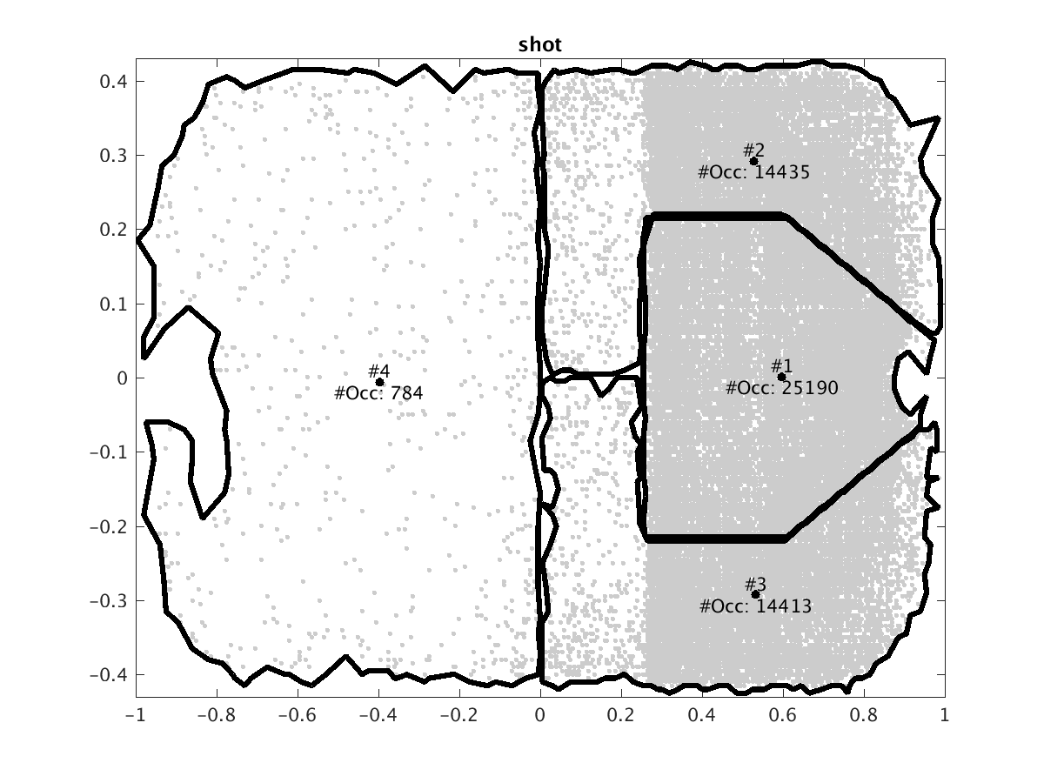
Locations
We discretize locations by clustering the points at which a given action occurs. Example:
Notes:
Action dependent, reduces number of parameters.
Should change scales to that grid points correspond to feet.

Slide 71
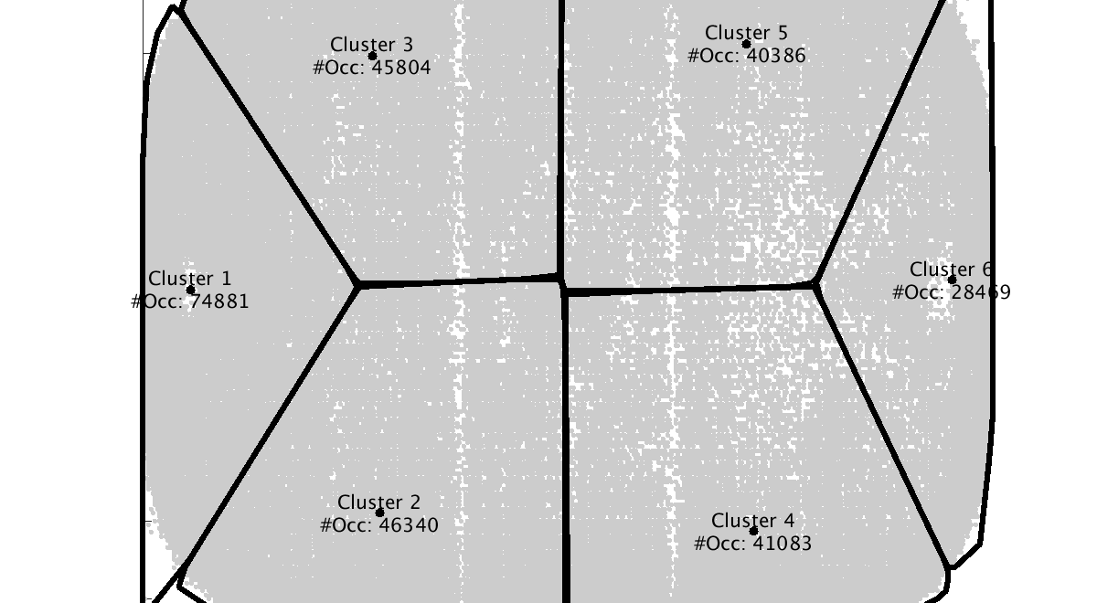
Loose Puck Recovery

Slide 72
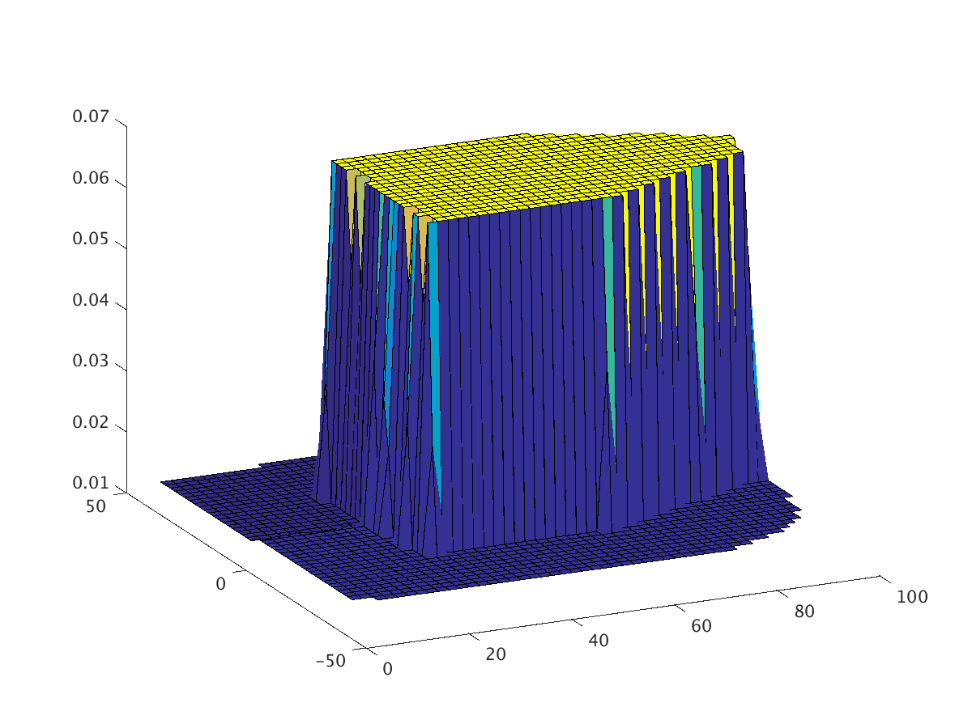
Action value @Location
Average values of actions at location, over all states and both teams.
Action = shot Chance of scoring the next goal lookahead = 1
Notes:
Loses information!
Shot to goal

Slide 73
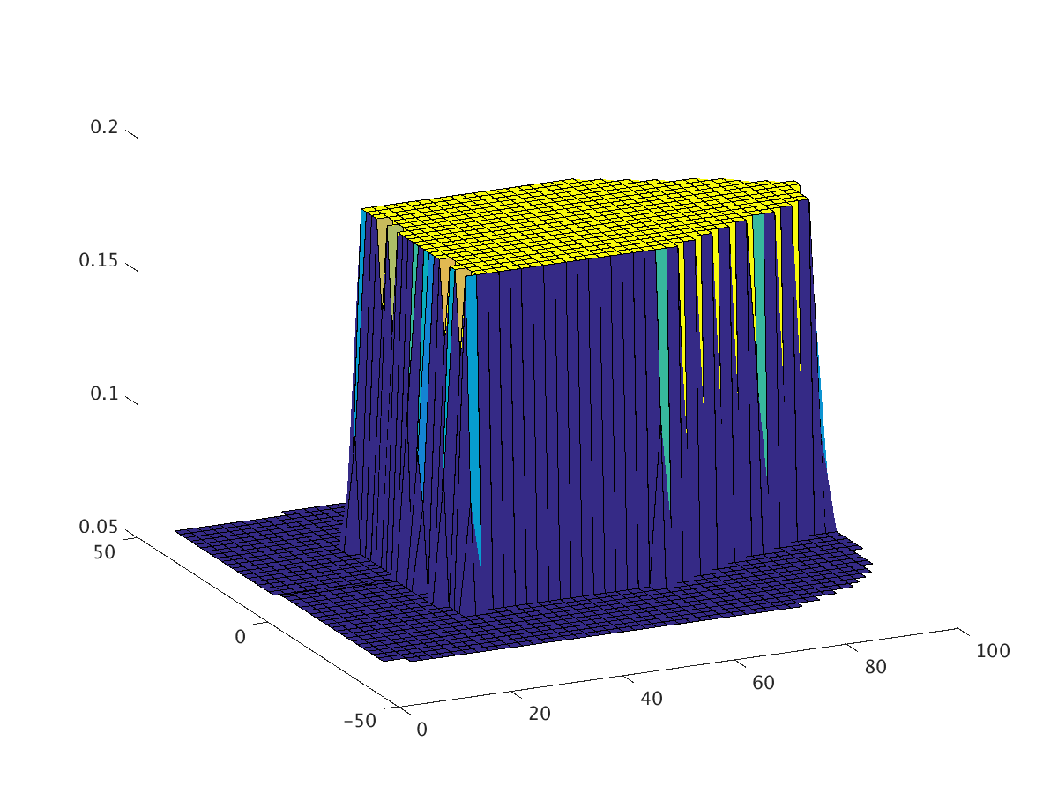
Shot Values, Lookahead
Chance of scoring the next goal lookahead = 1
Chance of scoring the next goal after shot lookahead = 14
Notes:
make scales bigger

Slide 74
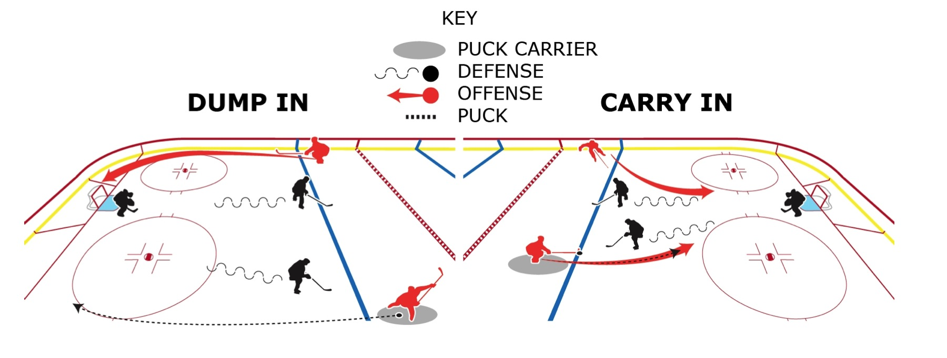
Dump in vs. Carry In
Which is better?
Figure by Shaun Kreider, Kreider Designs.

Slide 75
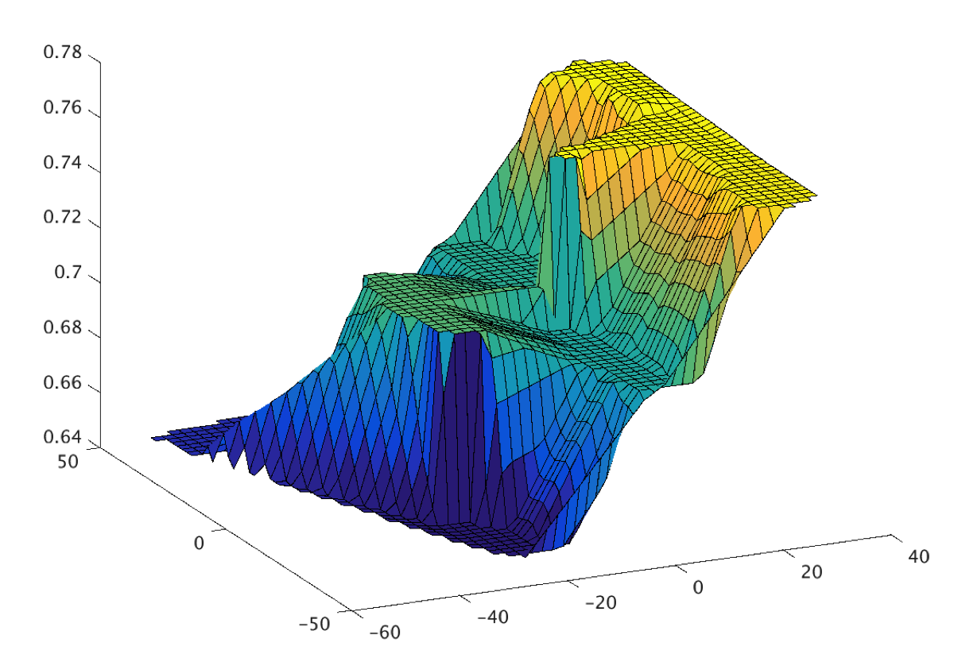
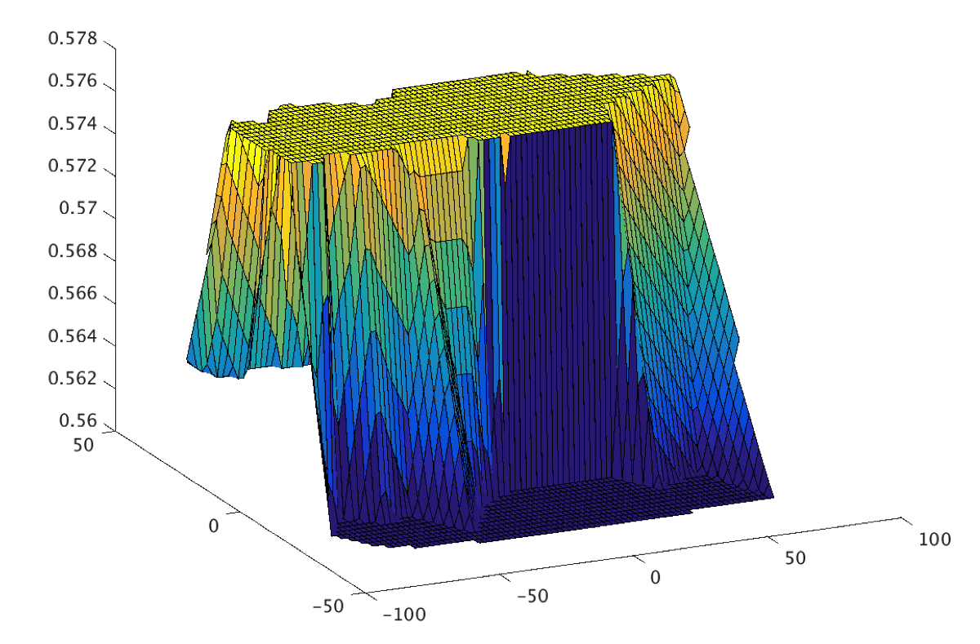
Model Values
Chance of scoring the next goal after dump-in
Chance of scoring the next goal after carry
Notes:
Carry is much better. Even though it’s further from the goal (see clusters).

Slide 76
Evaluating Players and Teams

Slide 77
The Impact of an Action
expected reward after action
expected reward before action

Slide 78
Evaluating Players and Teams
Players
Apply the impact of an action to the player performing the action
Sum the impact of his actions over a game to get his net game impact.
Sum the net game impact of a player over a single season to get his net season impact.
Teams Sum the impact of all players.

Slide 79
Team Performance
Compare
average impact of team in game (our model)
average goal ratio of team in game (independent metric). 2-1 = 4-2 = 6-3
Correlation = 0.7!
Notes:
this is common in blogs
each data point is a team

Slide 80
Team Performance lookahead = 1
Commonly used (e.g. Financial Times)
Correlation only 0.09
Notes:
they use shots only

Slide 81
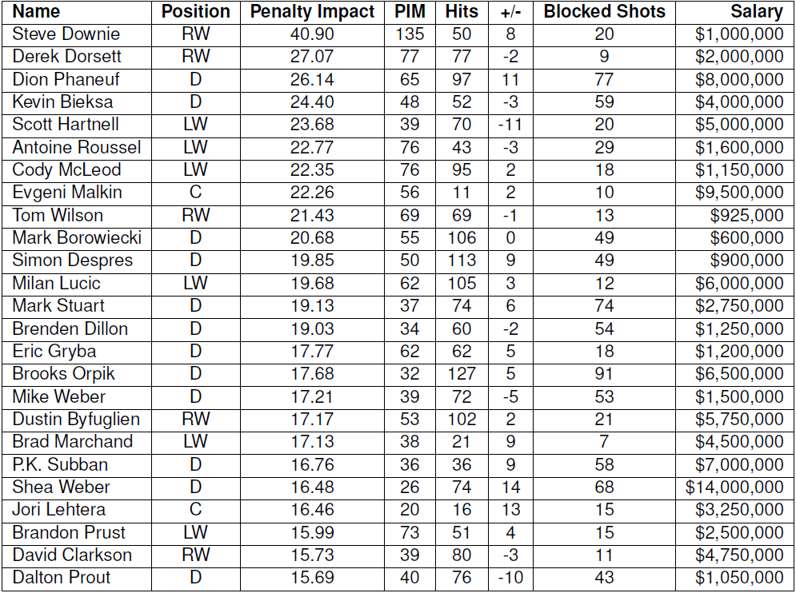
Player Impact on Penalties
2014-15 no location data
Notes:
Penalties are cost, so high value is bad
2 Canucks in top 4: Derek Dorsett and Kevin Bieksa

Slide 82
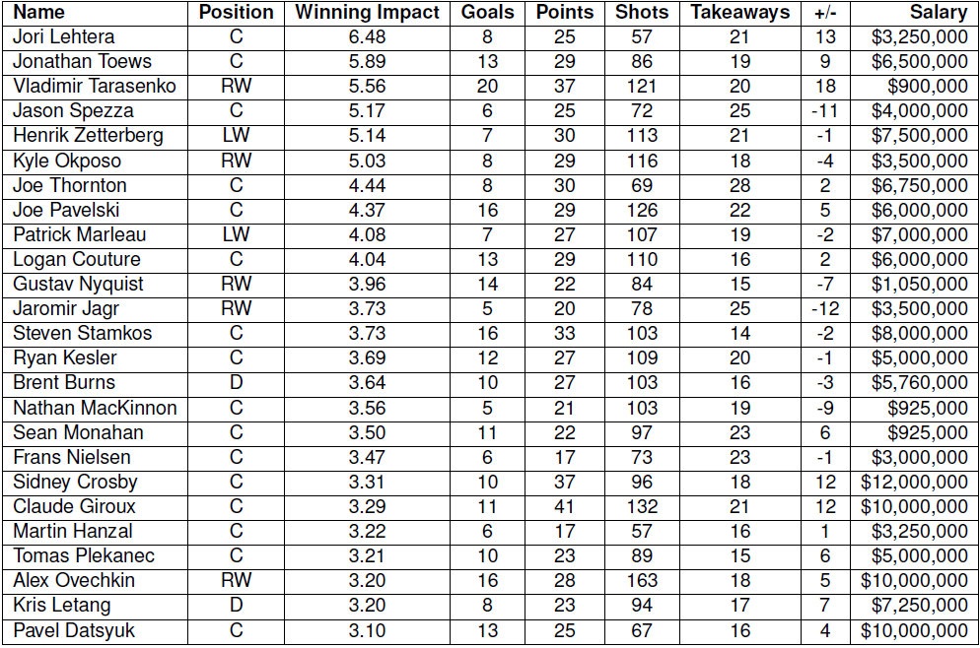
Player Impact on Wins
Notes:
Crosby and Ovechkin’s impact ranking falls from goals to wins, consistent with findings by Pettigrew, where they score many goals but have lower Added Goal Value

Slide 83
Demo
Value Iteration Demo
Notes:
start with 0 discount

